Slide 1
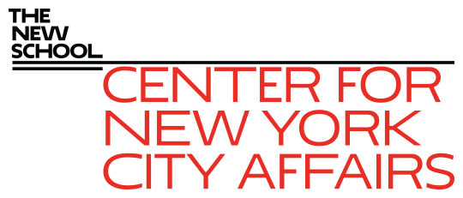
The New York City Labor Market Implications of Covid-19 James A. Parrott Center for New York City Affairs at The New School JamesParrott@newschool.edu www.centernyc.org New York City Employment and Training Coalition Workforce Business Council October 29, 2020 Funding support provided by Robin Hood Foundation, JPMorgan Chase Foundation, New York City Workforce Development Fund, New York Community Trust, 21st Century ILGWU Heritage Fund, and Consortium for Worker Education
James A. Parrott, PhD
Director of Economic and Fiscal Policies
Center for New York City Affairs
New School University
JamesParrott@newschool.edu

Slide 2
Economic Update: More precarious NYC economy than any time since the 1970s economic/fiscal crisis
Covid-19 economy job losses not like a recession. Lop-sided impact hitting hardest at low-paying services; high-paying inds. spared.
Altogether, 1.2-1.3 million NYC residents (1/3 of total workforce) receiving unemploy. benefits.
Disproportionate impact on persons of color, young adults, immigrants, entry-level workers.
Small, locally-owned businesses in greater jeopardy than ever.

Slide 3
In addition to enormous job losses, broader economic risks to NYC
Covid economy not only hitting certain industries hard and jeopardizing business survival,
But, poses severe challenge to how NYC functions—threatens arts, tourism, Manh. office-using econ., const. & NYC tax base.
We risk losing many of the gains achieved in recent years with low unemployment, strong job growth, and historic wage gains.

Slide 4
The Covid-19 crisis economy
3 groups of industries
Essential: health care, food, public safety and services
Face-to-face: restaurants, retail, arts, transportation, construction, local services
Remote: finance and real estate; profession services; higher education; information
=> A new strain of inequality hitting hardest at low-wage workers, many of color.

Slide 5
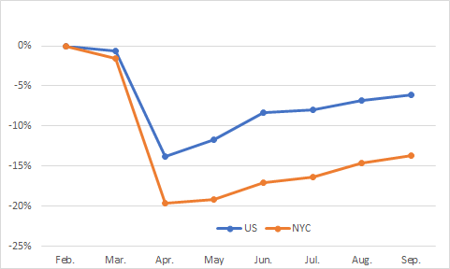
Since Feb., total jobs in NYC declined more and have rebounded less than for the nation overall—NYC jobs still down 14% vs. 6% for U.S.

Slide 6
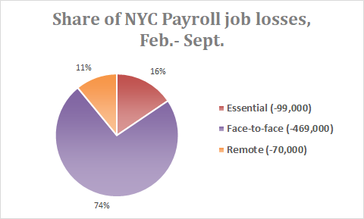
Note: self-employed and independent contractors have lost 500,000 + jobs
not included in the payroll job numbers.

Slide 7
3 charts showing NYC monthly payroll jobs change, Feb.-Sept. 2020

Slide 8
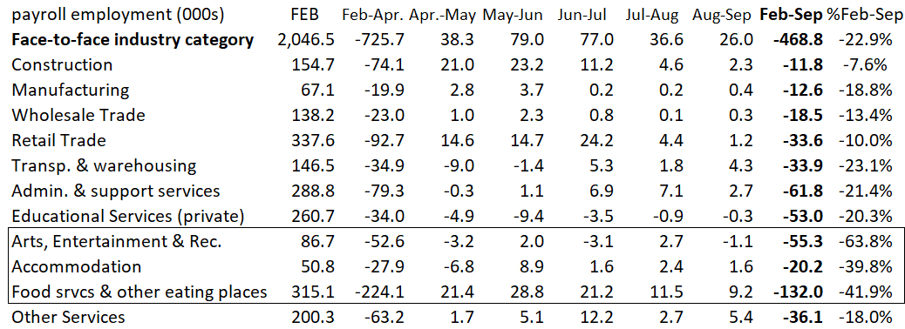

Slide 10
NYC industries with greatest job losses vs. the U.S. are all face-to-face industries
The reason NYC’s job losses are twice the national average is largely rooted in 5 industries, and related to arts, tourism and office jobs:
Transportation
Admin. srvcs (temp agencies & bldg. srvcs.)
Arts & entertainment
Hotels & restaurants
Retail

Slide 11
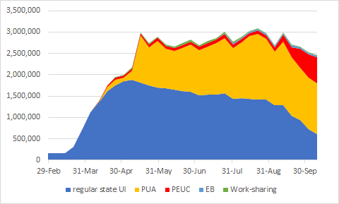
NYS continuing weekly UI claims to Oct. 10; NYC now accounts for 57% of statewide total.

Slide 12
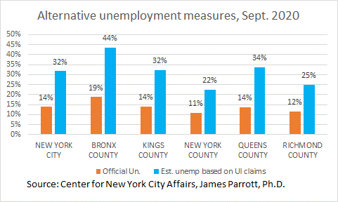
Official NYC unemployment rate vs. UI claims as % of February labor force, September 2020

Slide 13
CNYCA Covid-19 Economic Recovery Project
Analyze nature and magnitude of job displacements to inform NYC & NYS policy (UI , workers comp, small business aid, tax & budget issues)
Inform workforce development organizations regarding return to work, health & safety, training needs, and demand-side policies

Slide 14
The road from here?
No alternative to massive Federal economic support:
For workers and families
To keep small businesses alive
Need state policy changes to improve social & worker safety net.
To maintain public services and re-build our health care system
Ultimately, need Federal investments in mass transit, infrastructure and the caring economy.
Also need policies to ensure broadly shared prosperity, including expanded health care, and fair taxation.

