Slide 1
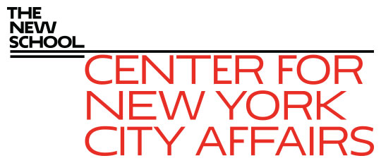
The Covid-19 impact on NYC’s healthcare workforce James A. Parrott Center for New York City Affairs at The New School JamesParrott@newschool.edu www.centernyc.org WPTI Employer Symposium Series—Healthcare, January 19, 2021 Funding support provided by Robin Hood Foundation, JPMorgan Chase Foundation, New York City Workforce Development Fund, New York Community Trust, 21st Century ILGWU Heritage Fund, and Consortium for Worker Education
James A. Parrott, PhD
Director of Economic and Fiscal Policies
Center for New York City Affairs
New School University
JamesParrott@newschool.edu

Slide 2
Overview
Covid’s impact on the health care sector is not a case of big job losses, but one where enormous pressure has been placed on the workforce that’s at ground zero.
We’ll look at the major sub-industries within healthcare, demographics, occupations, and pay.
We’ll look at the impacts on workers and the implications for workforce developers.

Slide 3
NYC has 658,000 public and private health care workers, making it by far largest NYC sector

Slide 4
A few fast facts on NYC healthcare
The combined public and private Healthcare sector employs 658,000 or 14% of all NYC payroll workers.
Rapid growth since 2000, with 192,000 private payroll jobs added in past decade, most in Ambulatory, particularly home healthcare.
The % of those w/o health insurance in NYC declined from 14.8% in 2010 to 6.9% (570,000) in 2019, but an est. 335,000 payroll workers lost health insurance since Feb.
Medicaid rolls rose 425,000 since Feb.

Slide 5
Employment in detailed Ambulatory industries

Slide 6
Demographics of NYC Healthcare workers compared to all private NYC wage workers
Healthcare workers are:
Much more heavily female (76% vs. 50%)
More likely to be workers of color, especially among public HC workers
Much more likely to be Black (34% priv. HC, 44% public HC vs. 20% for all private workers)
More likely to be immigrant (57% vs. 48%)
More likely to have a postgrad degree, and fewer with only HS or less
More workers in the middle pay ranges, fewer at either extreme

Slide 7
Leading occupations for healthcare practitioners, NY metro area, May 2019 OES

Slide 8
Leading healthcare support occupations, NY metro area, May 2019 OES

Slide 9
Frontline healthcare workers
Hospital industry not well-prepared: lack of PPE, equipment, structure for coordination
Incredible demands/long hours/stress on workers, many from communities hard hit
Challenges in dealing with great personal health risks
Tremendous mental health pressures (80% of nurses report negative mental health impacts due to Covid-19)

Slide 10
Challenges for workforce community
Balancing short-term and longer-term needs; some HC workers reluctant to work while some of the unemployed anxious for training to work in HC
High demand occupations: respiratory therapists, surgical technologists, pharmacy technicians, EMT paramedics
Need for community HC workers trusted by the community for education and vaccinations
Even higher demand for homecare workers than before yet pay is still very low
Digital divide challenges for training
Telehealth use accelerated

Slide 11
Public policy challenges
Successful vaccination program, and other measures to contain the pandemic
Creating a more resilient HC system, able to prevent future outbreaks and address inequities and community needs
Strengthen the HC workforce, including priorities laid out by Gov. Cuomo to address demand for entry-level workers and new pathways for HC careers, and more accessible credentialing programs.

Slide 12
Thank you. James Parrott Center for New York City Affairs The New School ParrottJ@newschool.edu

