Slide 1
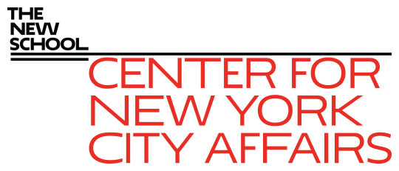
The current NYC Covid-19 economy and the outlook for 2021 James A. Parrott, PhD Center for New York City Affairs at The New School JamesParrott@newschool.edu www.centernyc.org Workforce Funders January 28, 2021 Funding support provided by the New York City Workforce Development Fund, New York Community Trust, JPMorgan Chase Foundation, Robin Hood Foundation, 21st Century ILGWU Heritage Fund, and Consortium for Worker Education
James A. Parrott, PhD
Director of Economic and Fiscal Policies
Center for New York City Affairs
New School University
JamesParrott@newschool.edu

Slide 2
2020 worst single-year NYC job loss since 1930s
Lost 700,000 payroll & independent contractor jobs
Gradual rebound from last spring’s plunge stalled in the fall and job count fell again in December
Federal aid passed at end of December and prospect for continued aid under Biden proposal, but job outlook bleak without new approaches
After vaccines, NYC could get back ½ of the 700,000 shortfall in 2021 but that still leaves big job hole

Slide 3
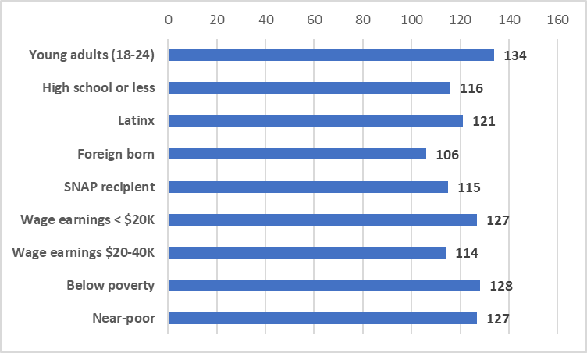
NYC index of concentrated Covid job loss (as of December)

Slide 4
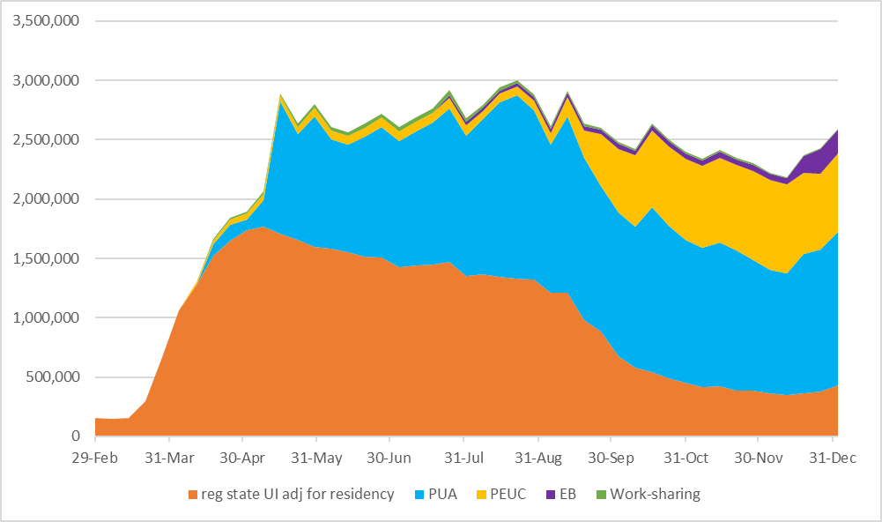
2.5 million NYS UI recipients; 1.25 million in NYC

Slide 5
Troubling signs all along labor market front
Entry level jobs hardest hit
Staggering levels of long-term unemployment
Many of workers called back only working part-time
Workers dropping out of labor force
Care-giving responsibilities and remote-learning children disproportionately fall on women’s shoulders

Slide 6
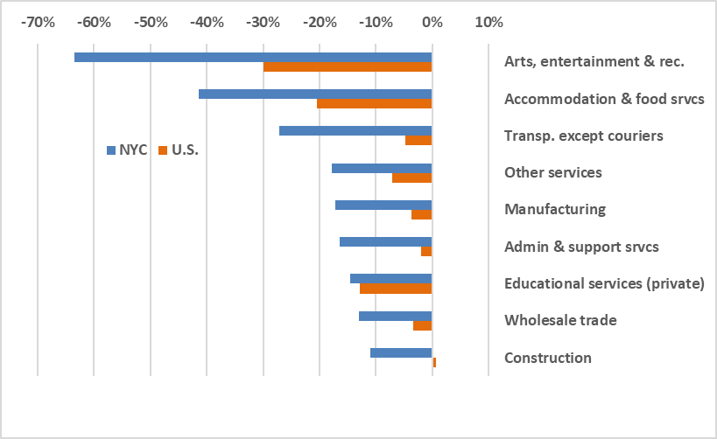
Steeper Feb.-Dec. job declines in NYC face-to-face industries

Slide 7
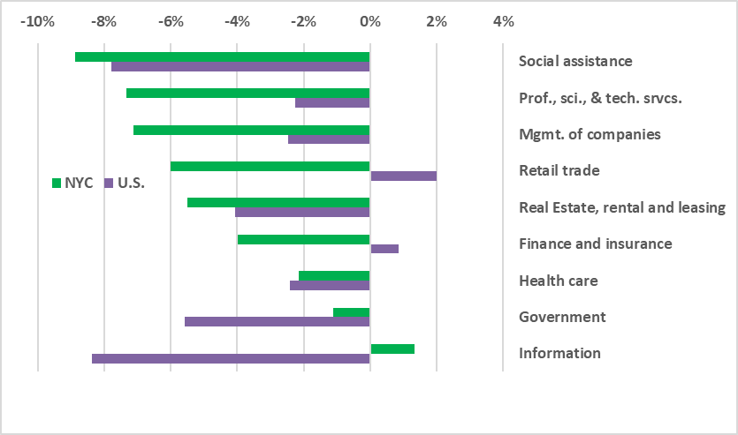
Smaller declines in essential and remote inds. but still worse than US

Slide 8
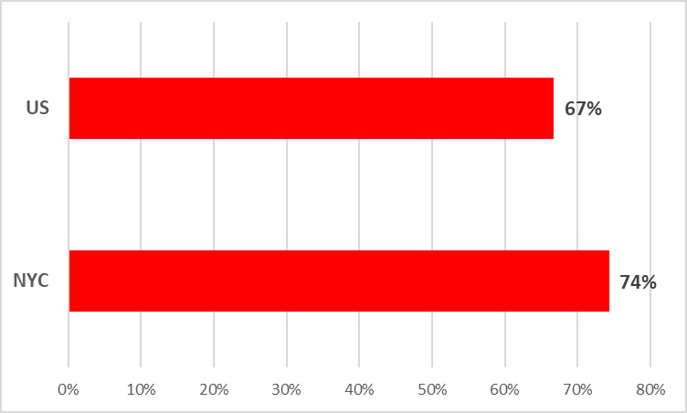
The only significant job gains are in delivery work where job quality is poor

Slide 9
Even when vaccinations are widespread, NYC economy will not snap back
Further improve NYS UI for workers called back part-time
Job quality needs to be on Albany agenda
NYC and NYS effectively manage safety net
Many beneficial programs in Pres. Biden’s package, but continuing assistance is not a substitute for spurring job creation
Priority needs for wage subsidy support, childcare and other social infrastructure investments as well as physical infrastructure

