Slide 1
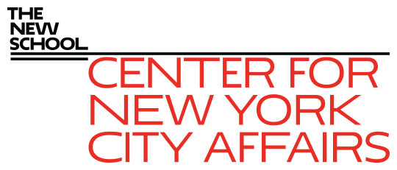
New York City’s unemployment crisis and workforce challenge James A. Parrott, PhD Center for New York City Affairs at The New School JamesParrott@newschool.edu www.centernyc.org NYC Workforce Funders October 13, 2021 Funding support provided by New York City Workforce Development Fund, Robin Hood Foundation, JPMorgan Chase Foundation, New York Community Trust, 21st Century ILGWU Heritage Fund, and the Consortium for Worker Education
James A. Parrott, PhD
Director of Economic and Fiscal Policies
Center for New York City Affairs
New School University
JamesParrott@newschool.edu

Slide 2
Overview
Getting the first ½ million jobs back was the easy part—the other ½ million will be much harder.
NYC job loss much greater than the nation’s overall.
Recognize and respond to the unprecedented scale of the unemployment crisis with approaches to “build back better.”
New York City and State have considerable Federal resources and rebounding tax revenues—lack of funding isn’t the constraint it usually is.

Slide 3
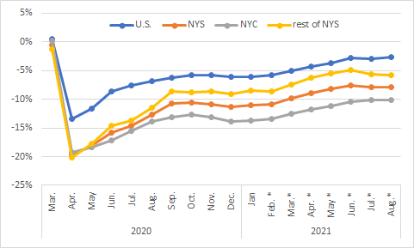
As of Aug., NYC jobs were 10.1% below Feb. 2020; more than 3.5 times the national 2.7% drop; NYS hit hardest among large states.

Slide 4
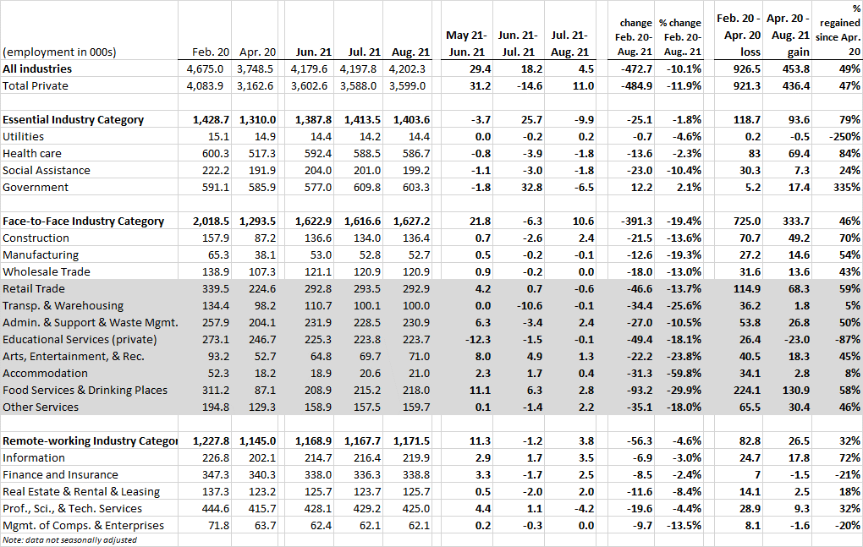
As of Aug., NYC still down 485,000 private payroll jobs since Feb. 2020; only 47% of lost priv. jobs have been regained (vs. 90% in rest of U.S.)

Slide 5
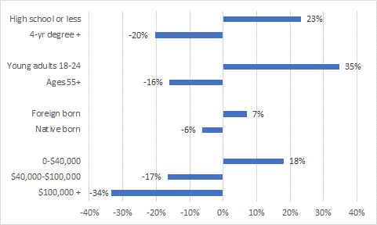
Workers of color are 75% of those losing jobs citywide; this chart shows likelihood of losing job compared to the average

Slide 6
Recognize and respond to the unprecedented scale of the unemployment crisis with approaches to “Build Back Better”
Why are workers not returning to their jobs?
Unemployment in Q2 was 26% for young adults (18-24). Factoring in invol. PT empl. and discouraged workers, NYC under-employment was 13% for White workers, 18% for Blacks, 20% for Latinx and 17% for Asian and other works.
61% of NYC’s unemployed had been jobless for > 6 months in Q2.
Covid’s broad economic impact has changed consumer demand and business practices, permanently reshuffling employment demands. Could provide opportunity for workers to trade up to better jobs.

Slide 7
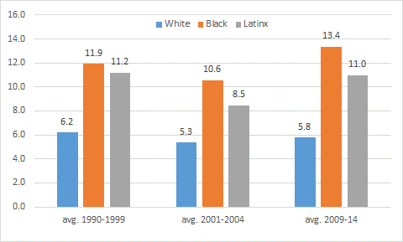
Following past NYC downturns, Black and Latinx workers faced double-digit unemployment for several years.

Slide 8
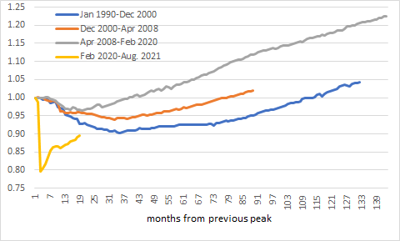
While the pandemic is different, for the last 3 downturns, it has taken NYC at least 38 mos. to reach previous peak jobs level, & that (post-Great Recession) was for a < 5% decline (vs. a 20% pandemic drop)

Slide 9
NYC and NYS have considerable Federal resources and rebounding tax revenues—lack of funding isn’t the constraint it usually is
NYS $12.75 billion in fiscal relief plus $38 billion in other Federal Covid relief. Fiscal relief funds were rec’d post-budget enactment and NYS apparently is still deciding how to allocate.
NYC will get $5.9 billion in Federal fiscal relief plus $14 billion in other Covid relief. While the City budgeted $250 million for the Cleanup Corps and $30 million to promote tourism (plus other spending), nearly $1 billion in fiscal relief is spread out over FYs 2023-25, with spending decisions tbd by leaders taking office 2022.
For both City and State, personal and bus’n income tax receipts are running well ahead of forecast levels.

Slide 10
CNYCA’s Covid-19 Economic Recovery Project
http://www.centernyc.org/covid19-economic-impact for all reports, updates, news coverage, presentations
Bi-weekly Economic Updates in NYC Employment and Training Coalition’s Workforce Weekly (https://nycetc.org/category/covid-19-economic-update/) and on the Center’s Covid-19 webpage
Recent report on Hospitality sector: http://www.centernyc.org/reports-briefs/hospitality-sector-in-the-wake-of-covid-19
Recent report with WPTI on the implications of the digital transformation for the workforce field: http://www.centernyc.org/reports-briefs/post-covid-workforce-development-jpyl8-7dsnr

Slide 11
Thank you. James Parrott Center for New York City Affairs The New School ParrottJ@newschool.edu
www.CenterNYC.org

